Slide 1
Graphics

Slide 2
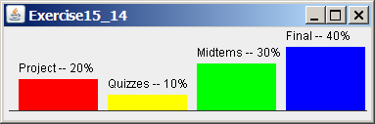
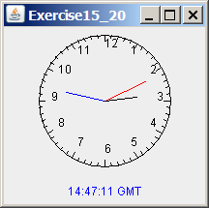
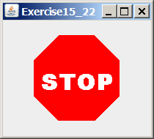
Motivations
If you want to draw shapes such as a bar chart, a clock, or a stop sign, how do you do it?

Slide 3
Java Coordinate System
To paint, you need to specify where to paint. Each component has its own coordinate system with the origin (0, 0) at the upper-left corner. The x-coordinate increases to the right, and the y-coordinate increases downward. Note that the Java coordinate system differs from the conventional coordinate system, as shown in Figure

Slide 4
The Java coordinate system is measured in pixels, with (0, 0) at its upper left corner.
The location of the upper-left corner of a component c1 (e.g., a button) inside its parent component c2 (e.g., a panel) can be located using c1.getX() and c1.getY().
As shown in
Figure 15.3, (x1, y1) = (c1.getX(), c1.getY()), (x2, y2) = (c2.getX(), c2.getY()), and (x3, y3) = (c3.getX(), c3.getY()).

Slide 5
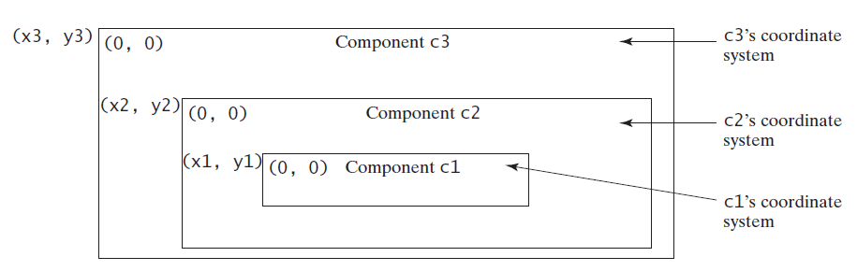
Each GUI component has its own coordinate system.

Slide 6
The Graphics Class
You can draw strings, lines, rectangles, ovals, arcs, polygons, and polylines, using the methods in the Graphics class.

Slide 7
Drawing Ovals
drawOval(int x, int y, int w, int h);
fillOval(int x, int y, int w, int h);

Slide 8
Drawing Strings
drawString(String s, int x, int y);
drawLine(int x1, int y1, int x2, int y2);
The drawString(String s, int x, int y) method draws a string starting at the point
(x, y) .
The drawLine(int x1, int y1, int x2, int y2) method draws a straight line from
point (x1, y1) to point (x2, y2)

Slide 9
Drawing Rectangles
drawRect(int x, int y, int w, int h);
fillRect(int x, int y, int w, int h);
The drawRect(int x, int y, int w, int h) method draws a plain rectangle, and the
fillRect(int x, int y, int w, int h) method draws a filled rectangle. The parameters
x and y represent the upper-left corner of the rectangle, and w and h are its width and height

Slide 10
Drawing Rounded Rectangles
drawRoundRect(int x, int y, int w, int h, int aw, int ah);
fillRoundRect(int x, int y, int w, int h, int aw, int ah);
The drawRoundRect(int x, int y, int w, int h, int aw, int ah) method draws a
round-cornered rectangle, and the fillRoundRect(int x, int y, int w, int h, int aw,
int ah) method draws a filled round-cornered rectangle. Parameters x, y, w, and h are the same as in the drawRect method, parameter aw is the horizontal diameter of the arcs at the corner, and ah is the vertical diameter of the arcs at the corner (see Figure 15.8(a)). In other words, aw and ah are the width and the height of the oval that produces a quarter-circle at each corner

Slide 11
Drawing Ovals
drawOval(int x, int y, int w, int h);
fillOval(int x, int y, int w, int h);
Depending on whether you wish to draw an oval in outline or filled solid, you can use either the
drawOval(int x, int y, int w, int h) method
or the
fillOval(int x, int y, int w, int h)
method.
An oval is drawn based on its bounding rectangle. Parameters x and y indicate the top-left corner of the bounding rectangle, and w and h indicate the width and height, respectively, of the bounding rectangle, as shown in Figure.

Slide 12
Case Study: The FigurePanel Class
This example develops a useful class for displaying various figures. The class enables the user to set the figure type and specify whether the figure is filled, and displays the figure on a panel.
FigurePanel

Slide 13
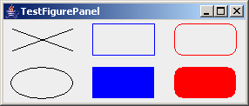
Test FigurePanel
This example develops a useful class for displaying various figures. The class enables the user to set the figure type and specify whether the figure is filled, and displays the figure on a panel.
TestFigurePanel

Slide 14
Drawing Arcs
drawArc(int x, int y, int w, int h, int angle1, int angle2);
fillArc(int x, int y, int w, int h, int angle1, int angle2);
Angles are in degree

Slide 15
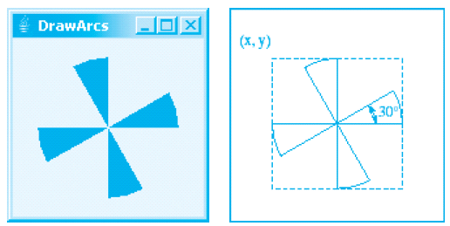
Drawing Arcs Example
DrawArcs
Run

Slide 16
Drawing Polygons and Polylines
int[] x = {40, 70, 60, 45, 20};
int[] y = {20, 40, 80, 45, 60};
g.drawPolygon(x, y, x.length);
g.drawPolyline(x, y, x.length);

Slide 17
Drawing Polygons Using the Polygon Class
Polygon polygon = new Polygon();
polygon.addPoint(40, 59);
polygon.addPoint(40, 100);
polygon.addPoint(10, 100);
g.drawPolygon(polygon);

Slide 18
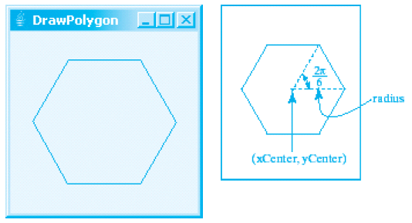
Drawing Polygons Example
DrawPolygon
Run

Slide 19
Centering Display Using the FontMetrics Class
You can display a string at any location in a panel. Can you display it centered? To do so, you need to use the FontMetrics class to measure the exact width and height of the string for a particular font. A FontMetrics can measure the following attributes:
public int getAscent()
public int getDescent()
public int getLeading()
public int getHeight()
public int stringWidth(String str)
getLeading()
getHeight()
getAscent()
getDescent()

Slide 20
The FontMetrics Class
FontMetrics is an abstract class. To get a FontMetrics object for a specific font, use the following getFontMetrics methods defined in the Graphics class:
· public FontMetrics getFontMetrics(Font f)
Returns the font metrics of the specified font.
· public FontMetrics getFontMetrics()
Returns the font metrics of the current font.

Slide 21
TestCenterMessage

Slide 22
Case Study: MessagePanel
This case study develops a useful class that displays a message in a panel. The class enables the user to set the location of the message, center the message, and move the message with the specified interval.
MessagePanel
TestMessagePanel
Run

Slide 23
Displaying Image Icons
You learned how to create image icons and display image icons in labels and buttons. For example, the following statements create an image icon and display it in a label:
ImageIcon icon = new ImageIcon("image/us.gif");
JLabel jlblImage = new JLabel(imageIcon);
An image icon displays a fixed-size image. To display an image in a flexible size, you need to use the java.awt.Image class. An image can be created from an image icon using the getImage() method as follows:
Image image = imageIcon.getImage();

Slide 24
Displaying Images
Using a label as an area for displaying images is simple and convenient, but you don't have much control over how the image is displayed. A more flexible way to display images is to use the drawImage method of the Graphics class on a panel. Four versions of the drawImage method are shown here.

Slide 25

Displaying Images Example
This example gives the code that displays an image from image/us.gif. The file image/us.gif is under the class directory. The Image from the file is created in the program. The drawImage method displays the image to fill in the whole panel, as shown in the figure.
DisplayImage

Slide 26
Case Study: ImageViewer Class
Displaying an image is a common task in Java programming. This case study develops a reusable component named ImageViewer that displays an image in a panel. The ImageViewer class contains the properties image, imageFilename, stretched, xCoordinate, and yCoordinate.

Slide 27
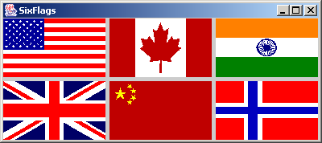
ImageView Example
This example gives an example that creates six images using the ImageViewer class.
SixFlags

Slide 28
The Graphics class–an abstract class—provides a device-independent graphics interface for displaying figures and images on the screen on different platforms. Whenever a component (e.g., a button, a label, a panel) is displayed, the JVM automatically creates a Graphics object for the component on the native platform and passes this object to invoke the paintComponent method to display the drawings.
The signature of the paintComponent method is as follows:
protected void paintComponent(Graphics g)
This method, defined in the JComponent class, is invoked whenever a component is first displayed or redisplayed.
In order to draw things on a component, you need to define a class that extends Jpanel and overrides its paintComponent method to specify what to draw.

Slide 29
Paint Component Example
import javax.swing.*;
import java.awt.Graphics;
public class TestPaintComponent extends JFrame {
public TestPaintComponent() {
add(new NewPanel());
}
public static void main(String[] args) {
TestPaintComponent frame = new TestPaintComponent();
frame.setTitle("TestPaintComponent");
frame.setSize(200, 100);
frame.setLocationRelativeTo(null); // Center the frame
frame.setDefaultCloseOperation(JFrame.EXIT_ON_CLOSE);
frame.setVisible(true);
}
}
class NewPanel extends JPanel {
protected void paintComponent(Graphics g) {
super.paintComponent(g);
g.drawLine(0, 0, 50, 50);
g.drawString("Banner", 0, 40);
}
}

Slide 30
Drawing methods of the graphics class
clearRect( )
copyArea()
drawArc()
Drawline()
Drawoval()
drawPolygon()

Slide 31
Drawing Geometric Figures
Drawing Strings
Drawing Lines
Drawing Rectangles
Drawing Ovals
Drawing Arcs
Drawing Polygons

Slide 32
Case Study: The FigurePanel Class
This example develops a useful class for displaying various figures. The class enables the user to set the figure type and specify whether the figure is filled, and displays the figure on a panel.
FigurePanel

Slide 33
Test FigurePanel
This example develops a useful class for displaying various figures. The class enables the user to set the figure type and specify whether the figure is filled, and displays the figure on a panel.

Slide 34
import java.awt.*;
import javax.swing.*;
public class TestFigurePanel extends JFrame {
public TestFigurePanel() {
setLayout(new GridLayout(2, 3, 5, 5));
add(new FigurePanel(FigurePanel.LINE));
add(new FigurePanel(FigurePanel.RECTANGLE));
add(new FigurePanel(FigurePanel.ROUND_RECTANGLE));
add(new FigurePanel(FigurePanel.OVAL));
add(new FigurePanel(FigurePanel.RECTANGLE, true));
add(new FigurePanel(FigurePanel.ROUND_RECTANGLE, true));
}
public static void main(String[] args) {
TestFigurePanel frame = new TestFigurePanel();
frame.setSize(400, 200);
frame.setTitle("TestFigurePanel");
frame.setLocationRelativeTo(null); // Center the frame
frame.setDefaultCloseOperation(JFrame.EXIT_ON_CLOSE);
frame.setVisible(true);
}
}

Slide 36
The Abstract Window Toolkit AWT
The Abstract Window Toolkit AWT contains numerous classes and methods that allow you to create and manage windows. It is also the foundation upon which Swing is built. Today, most Java programs employ user interfaces based on Swing. Because Swing provides richer implementations than does the AWT of some common GUI controls, such as buttons, lists, and check boxes, it is easy to jump to the conclusion that the AWT is no longer important, that it has been superseded by Swing. This assumption is, however, quite wrong. As mentioned, Swing is built on top of the AWT. Thus, many aspects of the AWT are also aspects of Swing. Furthermore, many AWT classes are used either directly or indirectly by Swing.

Slide 37
AWT Classes
The AWT classes are contained in the java.awt package. It is one of Java’s largest packages. Fortunately, because it is logically organized in a top-down, hierarchical fashion, it is easier to understand and use than you might at first believe.

Slide 40
Window Fundamentals
The AWT defines windows according to a class hierarchy that adds functionality and specificity with each level. The two most common windows are those derived from Panel, which is used by applets, and those derived from Frame, which creates a standard application window.
Component
At the top of the AWT hierarchy is the Component class. Component is an abstract class that encapsulates all of the attributes of a visual component. All user interface elements that are displayed on the screen and that interact with the user are subclasses of Component.
Container
The Container class is a subclass of Component. It has additional methods that allow other Component objects to be nested within it. Other Container objects can be stored inside of a Container (since they are themselves instances of Component). This makes for a multileveled containment system.

Slide 41
Panel
The Panel class is a concrete subclass of Container. It doesn’t add any new methods; it simply implements Container. A Panel may be thought of as a recursively nestable, concrete screen component. Panel is the super class for Applet. When screen output is directed to an applet, it is drawn on the surface of a Panel object. In essence, a Panel is a window that does not contain a title bar, menu bar, or border. This is why you don’t see these items when an applet is run inside a browser. When you run an applet using an applet viewer, the applet viewer provides the title and border.
Window
The Window class creates a top-level window. Atop-level window is not contained within any other object; it sits directly on the desktop. Generally, you won’t create Window objects directly. Instead, you will use a subclass of Window called Frame, described next.
Frame
Frame encapsulates what is commonly thought of as a “window.” It is a subclass of Window and has a title bar, menu bar, borders, and resizing corners. If you create a Frame object from within an applet, it will contain a warning message, such as “Java Applet Window,” to the user that an applet window has been created. This message warns users that the window they see was started by an applet and not by software running on their computer. (An applet that could masquerade as a host-based application could be used to obtain passwords and other sensitive information without the user’s knowledge.) When a Frame window is created by a stand-alone application rather than an applet, a normal window is created.

Slide 42
The class hierarchy for Panel and Frame

Slide 43
The Origins of Swing
Swing did not exist in the early days of Java. Rather, it was a response to deficiencies present in Java’s original GUI subsystem: the Abstract Window Toolkit. The AWT defines a basic set of controls, windows, and dialog boxes that support a usable, but limited graphical interface. One reason for the limited nature of the AWT is that it translates its various visual components into their corresponding, platform-specific equivalents, or peers. This means that the look and feel of a component is defined by the platform, not by Java. Because the AWT components use native code resources, they are referred to as heavyweight. Not long after Java’s original release, it became apparent that the limitations and restrictions present in the AWT were sufficiently serious that a better approach was needed. The solution was Swing. Introduced in 1997, Swing was included as part of the Java Foundation Classes (JFC). Swing was initially available for use with Java 1.1 as a separate library. However, beginning with Java 1.2, Swing (and the rest of the JFC) was fully integrated into Java.

Slide 44
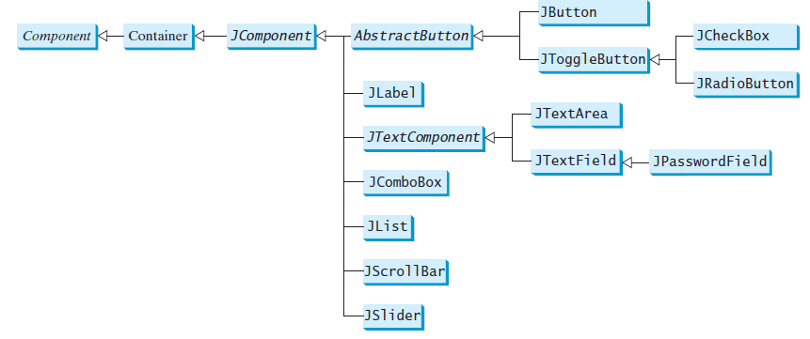
Swing GUI components which are frequently used to create user interfaces

Slide 45
Swing Is Built on the AWT
Before moving on, it is necessary to make one important point: although Swing eliminates a number of the limitations inherent in the AWT, Swing does not replace it. Instead, Swing is built on the foundation of the AWT. This is why the AWT is still a crucial part of Java. Swing also uses the same event handling mechanism as the AWT. Therefore, a basic understanding of the AWT and of event handling is required to use Swing.

Slide 46
Two Key Swing Features
As just explained, Swing was created to address the limitations present in the AWT. It does this through two key features: lightweight components and a pluggable look and feel. Together they provide an elegant, yet easy-to-use solution to the problems of the AWT. More than anything else, it is these two features that define the essence of Swing.

Slide 47
Swing Components Are Lightweight
With very few exceptions, Swing components are lightweight. This means that they are written entirely in Java and do not map directly to platform-specific peers. Because lightweight components are rendered using graphics primitives, they can be transparent, which enables nonrectangular shapes. Thus, lightweight components are more efficient and more flexible. Furthermore, because lightweight components do not translate into native peers, the look and feel of each component is determined by Swing, not by the underlying operating system. This means that each component will work in a consistent manner across all platforms.
Swing Supports a Pluggable Look and Feel
Swing supports a pluggable look and feel (PLAF). Because each Swing component is rendered by Java code rather than by native peers, the look and feel of a component is under the control of Swing. This fact means that it is possible to separate the look and feel of a component from the logic of the component, and this is what Swing does. Separating out the look and feel provides a significant advantage: it becomes possible to change the way that a component is rendered without affecting any of its other aspects. In other words, it is possible to “plug in” a new look and feel for any given component without creating any side effects in the code that uses that component.

Slide 48
The MVC Connection
In general, a visual component is a composite of three distinct aspects:
• The way that the component looks when rendered on the screen
• The way that the component reacts to the user
• The state information associated with the component
No matter what architecture is used to implement a component, it must implicitly contain these three parts. Over the years, one component architecture has proven itself to be exceptionally effective: Model-View-Controller, or MVC for short.
The MVC architecture is successful because each piece of the design corresponds to an aspect of a component. In MVC terminology, the model corresponds to the state information associated with the component. For example, in the case of a check box, the model contains a field that indicates if the box is checked or unchecked. The view determines how the component is displayed on the screen, including any aspects of the view that are affected by the current state of the model. The controller determines how the component reacts to the user. For example, when the user clicks a check box, the controller reacts by changing the model to reflect the user’s choice (checked or unchecked). This then results in the view being updated. By separating a component into a model, a view, and a controller, the specific implementation of each can be changed without affecting the other two.

Slide 49
Components and Containers
A Swing GUI consists of two key items: components and containers. However, this distinction is mostly conceptual because all containers are also components. The difference between the two is found in their intended purpose: As the term is commonly used, a component is an independent visual control, such as a push button or slider. A container holds a group of components. Thus, a container is a special type of component that is designed to hold other components. Furthermore, in order for a component to be displayed, it must be held within a container. Thus, all Swing GUIs will have at least one container. Because containers are components, a container can also hold other containers. This enables Swing to define what is called a containment hierarchy, at the top of which must be a top-level container.

Slide 50
Components
In general, Swing components are derived from the JComponent class. JComponent provides the functionality that is common to all components. For example, JComponent supports the pluggable look and feel. JComponent inherits the AWT classes Container and Component.Thus, a Swing component is built on and compatible with an AWT component. All of Swing’s components are represented by classes defined within the package javax.swing. The following table shows the class names for Swing components (including those used as containers). Notice that all component classes begin with the letter J. For example, the class for a label is JLabel; the class for a push button is JButton; and the class for a scroll bar is JScrollBar.

Slide 52
Containers
Swing defines two types of containers. The first are top-level containers: JFrame, JApplet, JWindow, and JDialog. These containers do not inherit JComponent. They do, however, inherit the AWT classes Component and Container. Unlike Swing’s other components, which are lightweight, the top-level containers are heavyweight. This makes the top-level containers a special case in the Swing component library. As the name implies, a top-level container must be at the top of a containment hierarchy . A top-level container is not contained within any other container. Furthermore, every containment hierarchy must begin with a top-level container. The one most commonly used for applications is JFrame. The one used for applets is JApplet. The second type of containers supported by Swing are lightweight containers. Lightweight containers do inherit JComponent. An example of a lightweight container is JPanel, which is a general-purpose container. Lightweight containers are often used to organize and
manage groups of related components because a lightweight container can be contained within another container. Thus, you can use lightweight containers such as JPanel to create subgroups of related controls that are contained within an outer container.

Slide 53
The Top-Level Container Panes
Each top-level container defines a set of panes. At the top of the hierarchy is an instance of JRootPane. JRootPane is a lightweight container whose purpose is to manage the other panes. It also helps manage the optional menu bar. The panes that comprise the root pane are called the glass pane, the content pane, and the layered pane. The glass pane is the top-level pane. It sits above and completely covers all other panes. By default, it is a transparent instance of JPanel.

Slide 54
The Swing Packages
Swing is a very large subsystem and makes use of many packages. These are the packages used by Swing that are defined by Java SE 6. The main package is javax.swing. This package must be imported into any program that uses Swing. It contains the classes that implement the basic Swing components, such as push buttons, labels, and check boxes.

Slide 56
A Simple Swing Application
Swing programs differ from both the console-based programs and the AWT-based programs shown earlier in this book. For example, they use a different set of components and a different container hierarchy than does the AWT. Swing programs also have special requirements that relate to threading. The best way to understand the structure of a Swing program is to work through an example. There are two types of Java programs in which Swing is typically used. The first is a desktop application. The second is the applet. This section shows how to create a Swing application. The creation of a Swing applet is described later in this chapter. Although quite short, the following program shows one way to write a Swing application. In the process, it demonstrates several key features of Swing. It uses two Swing components: JFrame and JLabel. JFrame is the top-level container that is commonly used for Swing
applications. JLabel is the Swing component that creates a label, which is a component that displays information. The label is Swing’s simplest component because it is passive. That is, a label does not respond to user input. It just displays output. The program uses a JFrame container to hold an instance of a JLabel. The label displays a short text message.

Slide 57
Buttons
A button is a component that triggers an action event when clicked. Swing provides regular buttons, toggle buttons, check box buttons, and radio buttons. The common features of these buttons are generalized in javax.swing.AbstractButton.

Slide 58
AbstractButton

Slide 59
JButton
JButton inherits AbstractButton and provides several constructors to create buttons.

Slide 60
JButton Constructors
The following are JButton constructors:
JButton()
JButton(String text)
JButton(String text, Icon icon)
JButton(Icon icon)

Slide 61
JButton Properties
text
icon
mnemonic
horizontalAlignment
verticalAlignment
horizontalTextPosition
verticalTextPosition
iconTextGap

Slide 62
Default Icons, Pressed Icon, and Rollover Icon
A regular button has a default icon, pressed icon, and rollover icon. Normally, you use the default icon. All other icons are for special effects. A pressed icon is displayed when a button is pressed and a rollover icon is displayed when the mouse is over the button but not pressed.
(A) Default icon (B) Pressed icon (C) Rollover icon

Slide 63
Demo
TestButtonIcons

Slide 64
Horizontal Alignments
Horizontal alignment specifies how the icon and text are placed horizontally on a button. You can set the horizontal alignment using one of the five constants: LEADING, LEFT, CENTER, RIGHT, TRAILING. At present, LEADING and LEFT are the same and TRAILING and RIGHT are the same. Future implementation may distinguish them. The default horizontal alignment is SwingConstants.TRAILING.

Slide 65
Vertical Alignments
Vertical alignment specifies how the icon and text are placed vertically on a button. You can set the vertical alignment using one of the three constants: TOP, CENTER, BOTTOM. The default vertical alignment is SwingConstants.CENTER.

Slide 66
Horizontal Text Positions
Horizontal text position specifies the horizontal position of the text relative to the icon. You can set the horizontal text position using one of the five constants: LEADING, LEFT, CENTER, RIGHT, TRAILING. The default horizontal text position is SwingConstants.RIGHT.

Slide 67
Vertical Text Positions
Vertical text position specifies the vertical position of the text relative to the icon. You can set the vertical text position using one of the three constants: TOP, CENTER. The default vertical text position is SwingConstants.CENTER.

Slide 68
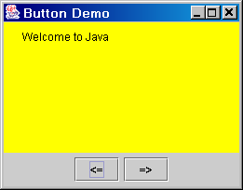
Example: Using Buttons
Write a program that displays a message on a panel and uses two buttons, <= and =>, to move the message on the panel to the left or right.
ButtonDemo

Slide 69
JCheckBox
JCheckBox inherits all the properties such as text, icon, mnemonic, verticalAlignment, horizontalAlignment, horizontalTextPosition, verticalTextPosition, and selected from AbstractButton, and provides several constructors to create check boxes.

Slide 70
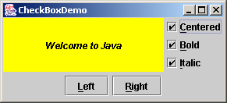
Example: Using Check Boxes
Add three check boxes named Centered, Bold, and Italic into the ButtonDemo example to let the user specify whether the message is centered, bold, or italic.
ButtonDemo
CheckBoxDemo
CheckBoxDemo
Run

Slide 71
JRadioButton
Radio buttons are variations of check boxes. They are often used in the group, where only one button is checked at a time.

Slide 72
Grouping Radio Buttons
ButtonGroup btg = new ButtonGroup();
btg.add(jrb1);
btg.add(jrb2);

Slide 73
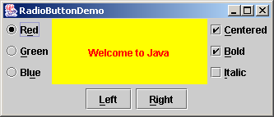
Example: Using Radio Buttons
Add three radio buttons named Red, Green, and Blue into the preceding example to let the user choose the color of the message.
ButtonDemo
CheckBoxDemo
RadioButtonDemo
RadioButtonDemo
Run

Slide 74
JLabel
A label is a display area for a short text, an image, or both.

Slide 75
JLabel Constructors
The constructors for labels are as follows:
JLabel()
JLabel(String text, int horizontalAlignment)
JLabel(String text)
JLabel(Icon icon)
JLabel(Icon icon, int horizontalAlignment)
JLabel(String text, Icon icon, int horizontalAlignment)

Slide 76
JLabel Properties
JLabel inherits all the properties from JComponent and has many properties similar to the ones in JButton, such as text, icon, horizontalAlignment, verticalAlignment, horizontalTextPosition, verticalTextPosition, and iconTextGap.

Slide 77
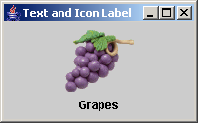
Using Labels
// Create an image icon from image file
ImageIcon icon = new ImageIcon("image/grapes.gif");
// Create a label with text, an icon,
// with centered horizontal alignment
JLabel jlbl = new JLabel("Grapes", icon, SwingConstants.CENTER);
// Set label's text alignment and gap between text and icon
jlbl.setHorizontalTextPosition(SwingConstants.CENTER);
jlbl.setVerticalTextPosition(SwingConstants.BOTTOM);
jlbl.setIconTextGap(5);

Slide 78
JTextField
A text field is an input area where the user can type in characters. Text fields are useful in that they enable the user to enter in variable data (such as a name or a description).

Slide 79
JTextField Constructors
JTextField(int columns)
Creates an empty text field with the specified number of columns.
JTextField(String text)
Creates a text field initialized with the specified text.
JTextField(String text, int columns)
Creates a text field initialized with the specified text and the column size.

Slide 80
JTextField Properties
text
horizontalAlignment
editable
columns

Slide 81
JTextField Methods
getText()
Returns the string from the text field.
setText(String text)
Puts the given string in the text field.
setEditable(boolean editable)
Enables or disables the text field to be edited. By default, editable is true.
setColumns(int)
Sets the number of columns in this text field. The length of the text field is changeable.

Slide 82
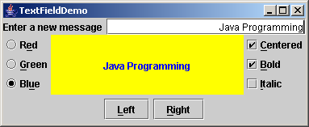
Example: Using Text Fields
Add a text field to the preceding example to let the user set a new message.
TextFieldDemo

Slide 83
JTextArea
If you want to let the user enter multiple lines of text, you cannot use text fields unless you create several of them. The solution is to use JTextArea, which enables the user to enter multiple lines of text.

Slide 84
JTextArea Constructors
JTextArea(int rows, int columns)
Creates a text area with the specified number of rows and columns.
JTextArea(String s, int rows, int columns)
Creates a text area with the initial text and the number of rows and columns specified.

Slide 85
JTextArea Properties
text
editable
columns
lineWrap
wrapStyleWord
rows
lineCount
tabSize

Slide 86
Example: Using Text Areas
This example gives a program that displays an image in a label, a title in a label, and a text in a text area.

Slide 87
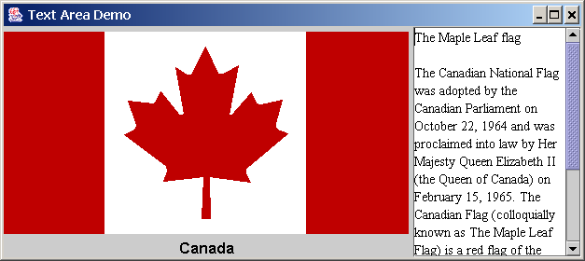
Example, cont.
TextAreaDemo
Run

Slide 88
JComboBox
A combo box is a simple list of items from which the user can choose. It performs basically the same function as a list, but can get only one value.

Slide 89
JComboBox Methods
To add an item to a JComboBox jcbo, use
jcbo.addItem(Object item)
To get an item from JComboBox jcbo, use
jcbo.getItem()

Slide 90
Using the itemStateChanged Handler
When a choice is checked or unchecked, itemStateChanged() for ItemEvent is invoked as well as the actionPerformed() handler for ActionEvent.
public void itemStateChanged(ItemEvent e) {
// Make sure the source is a combo box
if (e.getSource() instanceof JComboBox)
String s = (String)e.getItem();
}

Slide 91
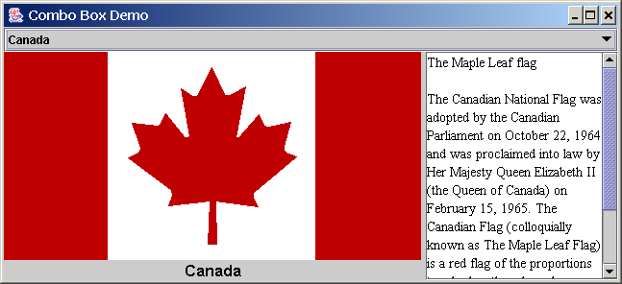
Example: Using Combo Boxes
This example lets users view an image and a description of a country's flag by selecting the country from a combo box.
ComboBoxDemo

Slide 92
JList
A list is a component that performs basically the same function as a combo box, but it enables the user to choose a single value or multiple values.

Slide 93
JList Constructors
JList()
Creates an empty list.
JList(Object[] stringItems)
Creates a new list initialized with items.

Slide 94
JList Properties
selectedIndexd
selectedIndices
selectedValue
selectedValues
selectionMode
visibleRowCount

Slide 95
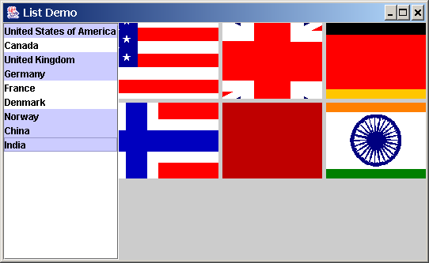
Example: Using Lists
This example gives a program that lets users select countries in a list and display the flags of the selected countries in the labels.
ListDemo

Slide 96
JScrollBar
A scroll bar is a control that enables the user to select from a range of values. The scrollbar appears in two styles: horizontal and vertical.

Slide 97
Scroll Bar Properties

Slide 98
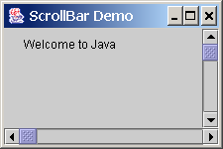
Example: Using Scrollbars
This example uses horizontal and vertical scrollbars to control a message displayed on a panel. The horizontal scrollbar is used to move the message to the left or the right, and the vertical scrollbar to move it up and down.
ScrollBarDemo

Slide 99
JSlider
JSlider is similar to JScrollBar, but JSlider has more properties and can appear in many forms.

Slide 100
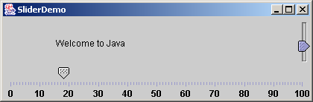
Example: Using Sliders
Rewrite the preceding program using the sliders to control a message displayed on a panel instead of using scroll bars.
SliderDemo
Run

Slide 101
Creating Multiple Windows
The following slides show step-by-step how to create an additional window from an application or applet.

Slide 102
Creating Additional Windows, Step 1
Step 1: Create a subclass of JFrame (called a SubFrame) that tells the new window what to do. For example, all the GUI application programs extend JFrame and are subclasses of JFrame.

Slide 103
Creating Additional Windows, Step 2
Step 2: Create an instance of SubFrame in the application or applet.
Example:
SubFrame subFrame = new
SubFrame("SubFrame Title");

Slide 104
Creating Additional Windows, Step 3
Step 3: Create a JButton for activating the subFrame.
add(new JButton("Activate SubFrame"));

Slide 105
Creating Additional Windows, Step 4
Step 4: Override the actionPerformed() method as follows:
public actionPerformed(ActionEvent e) {
String actionCommand = e.getActionCommand();
if (e.target instanceof Button) {
if ("Activate SubFrame".equals(actionCommand)) {
subFrame.setVisible(true);
}
}
}

Slide 106
Example: Creating Multiple Windows
This example creates a main window with a text area in the scroll pane, and a button named "Show Histogram." When the user clicks the button, a new window appears that displays a histogram to show the occurrence of the letters in the text area.

Slide 107
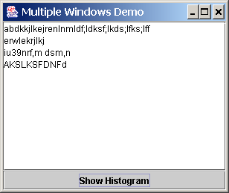
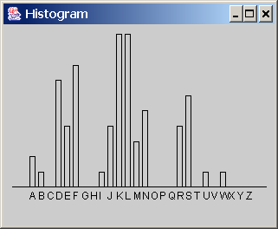
Example, cont.
MultipleWindowsDemo
Histogram

